Slide 1
Chapter 4
Control Structures I (Selection)

Slide 2
Review
Which of the following statements about the putback() function in C++ is correct?
A. The putback() function discards the last character read from the input stream.
B. The putback() function returns a character to the input stream, so it can be read again.
C. The putback() function replaces the last character in the output stream with a new one.
D. The putback() function clears all errors in the input stream.

Slide 3
Which of the following statements about the peek() function in C++ is correct?
A. The peek() function removes the next character from the input stream without reading it.
B. The peek() function reads the next character from the input stream but does not extract it.
C. The peek() function clears all errors in the input stream.
D. The peek() function discards the next character in the input stream and moves to the next one.

Slide 4
Which of the following statements about the ignore() function in C++ is correct?
A. The ignore() function reads and extracts all remaining characters from the input stream.
B. The ignore() function skips a specified number of characters or until a specified delimiter in the input stream.
C. The ignore() function clears all error flags from the input stream.
D. The ignore() function replaces the next character in the input stream with a new one.

Slide 5
Which of the following statements about the static_cast in C++ is correct?
A. The static_cast can be used to cast between unrelated types such as converting a string to an int.
B. The static_cast performs runtime type checking to ensure safe conversions.
C. The static_cast is used to perform explicit conversions between related types at compile time.
D. The static_cast automatically converts between types without needing explicit specification.

Slide 6
Which of the following statements about file input/output (I/O) in C++ is correct?
A. The ofstream object is used for reading data from a file.
B. The ifstream object is used for writing data to a file.
C. The ofstream object is used to write data to a file, and the ifstream object is used to read data from a file.
D. The fstream object can only be used for reading from a file, not writing.

Slide 7
Objectives (1 of 2)
In this chapter, you will:
Learn about control structures
Examine relational operators
Discover how to use the selection control structures if, if…else
Examine int and bool data types and logical (Boolean) expressions
Examine logical operators
Explore how to form and evaluate logical (Boolean) expressions

Slide 8
Objectives (2 of 2)
Learn how relational operators work with the string type
Become aware of short-circuit evaluation
Learn how the conditional operator, ?:, works
Learn how to use pseudocode to develop, test, and debug a program
Discover how to use a switch statement in a program
Learn how to avoid bugs by avoiding partially understood concepts
Learn how to use the assert function to terminate a program

Slide 9
Control Structures (1 of 2)
A computer can proceed:
In sequence
Selectively (branch): making a choice
Repetitively: looping
By calling a function
The two most common control structures are:
Selection
Repetition

Slide 10
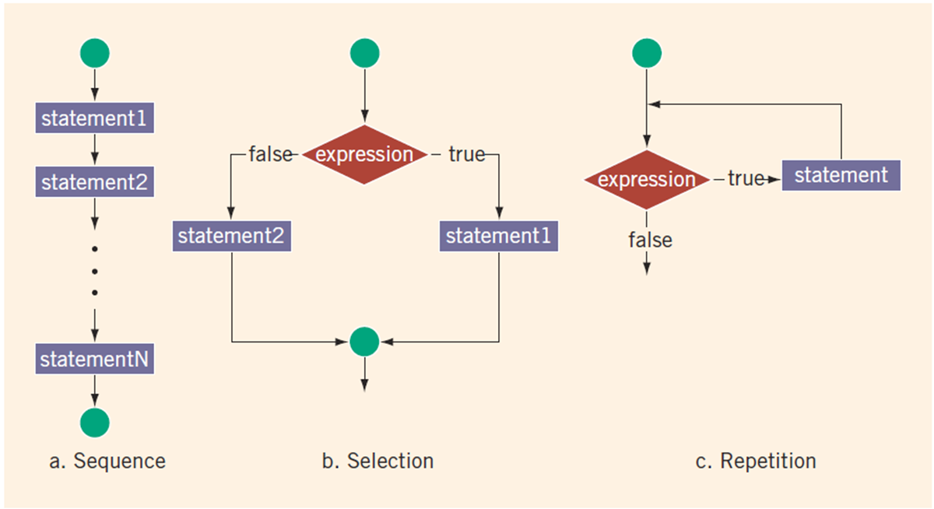
Control Structures (2 of 2)
FIGURE 4-1 Flow of execution

Slide 11
Selection: if and if...else
An expression that evaluates to true or false is called a logical expression
“8 is greater than 3” is true

Slide 12
Relational Operators
TABLE 4-1 Relational Operators in C++
Operator | Description
== | equal to
!= | not equal to
< | less than
<= | less than or equal to
> | greater than
>= | greater than or equal to
Each relational operator is a binary operator (requires two operands)
Expressions using these operators always evaluate to true or false

Slide 13
Relational Operators and Simple Data Types
You can use the relational operators with all three simple data types
EXAMPLE 4-1
Expression | Meaning | Value
8 < 15 | 8 is less than 15 | True
6 != 6 | 6 is not equal to 6 | false
2.5 > 5.8 | 2.5 is greater than 5.8 | false
5.9 <= 7.5 | 5.9 is less than or equal to 7.5 | true
7 <= 10.4 | 7 is less than or equal to 10.4 | true

Slide 14

Comparing Characters
In an expression of char values using relational operators:
The result depends on the machine’s collating sequence
ASCII character set
Logical (Boolean) expressions:
Include expressions such as
Return an integer value of 1 if the logical expression evaluates to true
Return an integer value of 0 otherwise

Slide 15
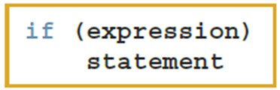
One-Way Selection (1 of 2)
One-way selection syntax
The statement is:
Executed if the value of the expression is true
Bypassed if the value is false; program goes to the next statement
The expression is also called a decision maker
The statement following the expression is also called the action statement

Slide 16
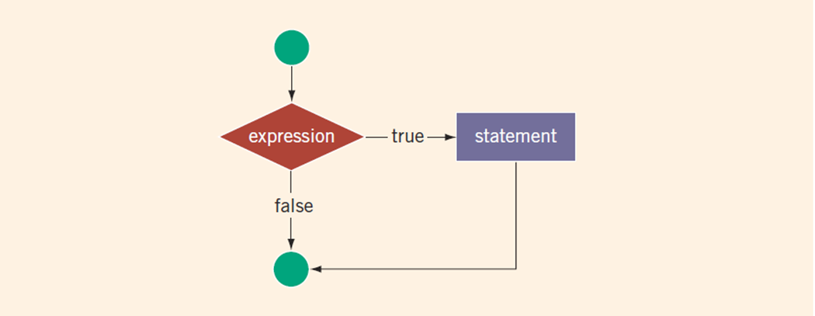
One-Way Selection (2 of 2)
FIGURE 4-2 One-way selection

Slide 17
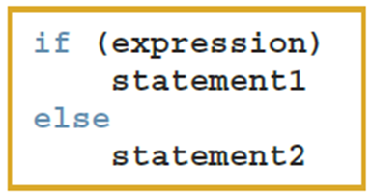
Two-Way Selection (1 of 2)
Two-way selection syntax
If expression is true, statement1 is executed; otherwise, statement2 is executed
statement1 and statement2 are any C++ statements

Slide 18
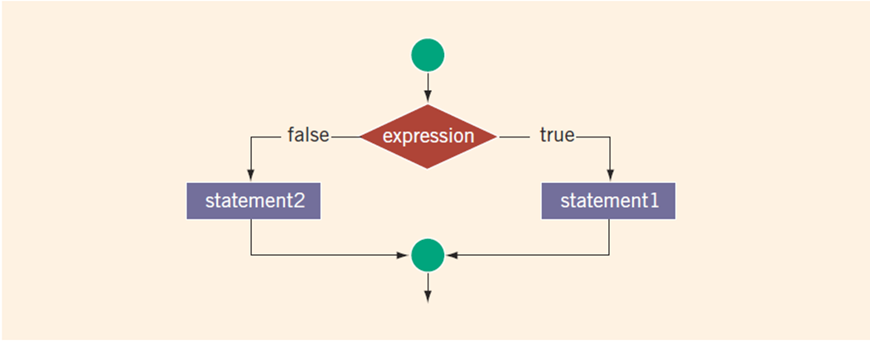
Two-Way Selection (2 of 2)
FIGURE 4-3 Two-way selection

Slide 19
int Data Type and Logical (Boolean) Expressions
Earlier versions of C++ did not provide built-in data types that had Boolean values
Logical expressions evaluate to either 1 or 0
Logical expression value was stored in a variable of the data type int
You can use the int data type to manipulate logical (Boolean) expressions

Slide 20
bool Data Type and Logical (Boolean) Expressions
The data type bool has logical (Boolean) values true and false
bool, true, and false are reserved words
The identifier true has the value 1
The identifier false has the value 0

Slide 21
Logical (Boolean) Operators and Logical Expressions (1 of 5)
Logical (Boolean) operators enable you to combine logical expressions
TABLE 4-2 Logical (Boolean) Operators in C++
Operator | Description
! | not
&& | and
|| | or

Slide 22
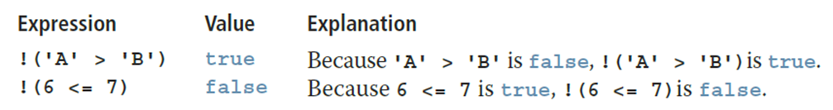
Logical (Boolean) Operators and Logical Expressions (2 of 5)
TABLE 4-3 The ! (Not) Operator
Expression | !(Expression)
true (nonzero) | false (0)
false (0) | true (1)
EXAMPLE 4-10

Slide 23
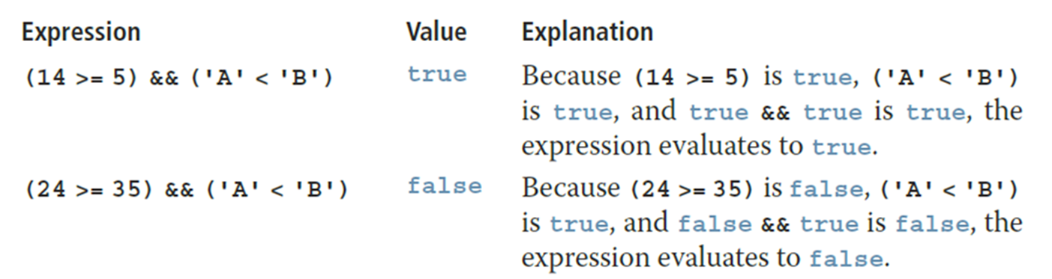
Logical (Boolean) Operators and Logical Expressions (3 of 5)
TABLE 4-4 The && (And) Operator
Expression1 | Expression2 | Expression1 && Expression2
true (nonzero) | true (nonzero) | true (1)
true (nonzero) | false (0) | false (0)
false (0) | true (nonzero) | false (0)
false (0) | false (0) | false (0)
EXAMPLE 4-11

Slide 24
Logical (Boolean) Operators and Logical Expressions (4 of 5)
TABLE 4-5 The || (Or) Operator
Expression1 | Expression2 | Expression1 || Expression2
true (nonzero) | true (nonzero) | true (1)
true (nonzero) | false (0) | true (1)
false (0) | true (nonzero) | true (1)
false (0) | false (0) | false (0)

Slide 25
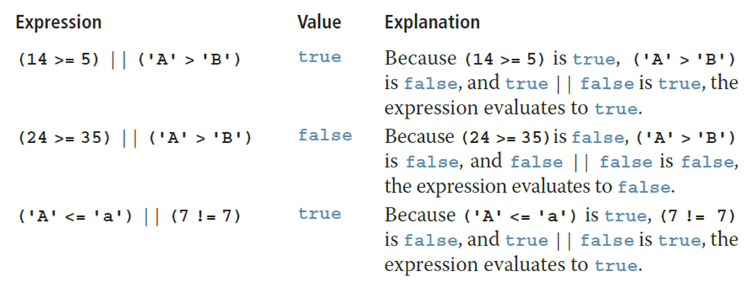
Logical (Boolean) Operators and Logical Expressions (5 of 5)
EXAMPLE 4-12

Slide 26
Order of Precedence (1 of 5)
Relational and logical operators are evaluated from left to right
The associativity is left to right
Parentheses can override precedence

Slide 27
Order of Precedence (2 of 5)
TABLE 4-6 Precedence of Operators
Operators | Precedence
!, +, - (unary operators) | first
*, /, % | second
+, - | third
<, <=, >=, > | fourth
==, != | fifth
&& | sixth
|| | seventh
= (assignment operator) | last

Slide 28
Order of Precedence (3 of 5)
EXAMPLE 4-13
Suppose you have the following declarations:
bool found = true;
int age = 20;
double hours = 45.30;
double overTime = 15.00;
int count = 20;
char ch = 'B';

Slide 29
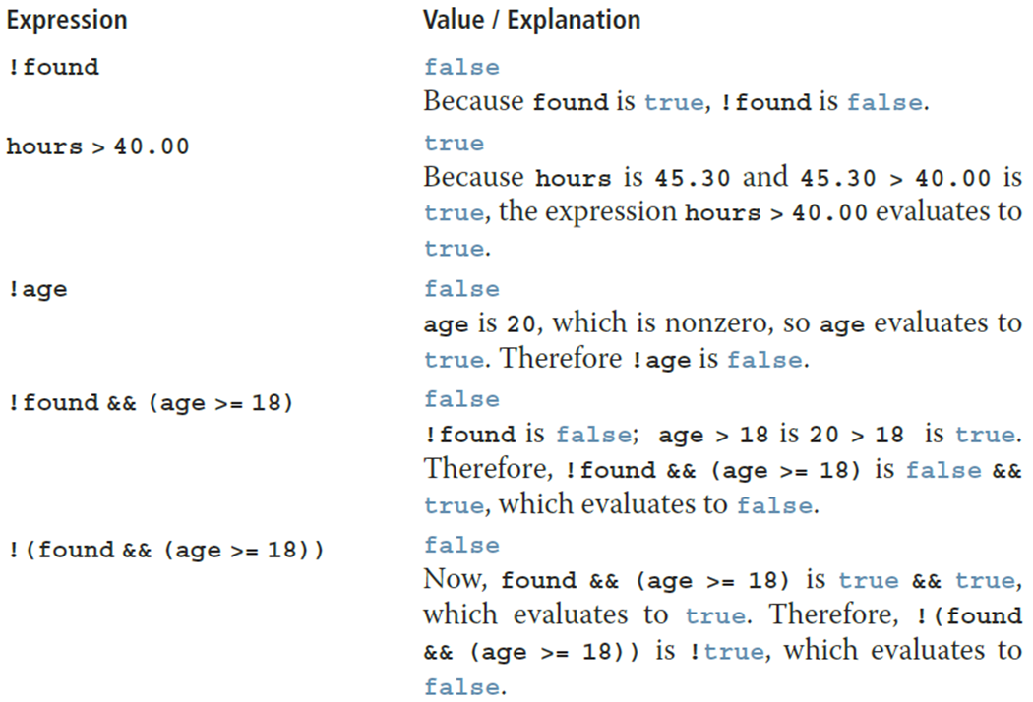
Order of Precedence (4 of 5)

Slide 30
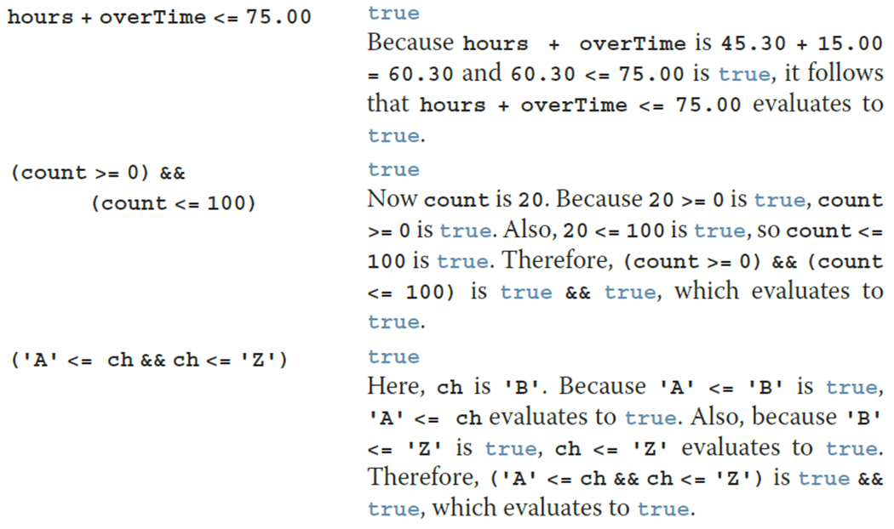
Order of Precedence (5 of 5)

Slide 31
Relational Operators and the string Type (1 of 5)
Relational operators can be applied to variables of type string
Strings are compared character by character, starting with the first character
Comparison continues until either a mismatch is found or all characters are found equal
If two strings of different lengths are compared and the comparison is equal to the last character of the shorter string
The shorter string is less than the larger string

Slide 32
Relational Operators and the string Type (2 of 5)
EXAMPLE 4-13
Suppose you have the following declarations:
bool found = true;
int age = 20;
double hours = 45.30;
double overTime = 15.00;
int count = 20;
char ch = 'B';

Slide 33
Relational Operators and the string Type (3 of 5)
Expression | Value/Explanation
str1 < str2 | true str1 = "Hello" and str2 = "Hi". The first character of str1 and str2 are the same, but the second character 'e' of str1 is less than the second character 'i' of str2. Therefore, str1 < str2 is true.
str1 > "Hen" | false str1 = "Hello". The first two characters of str1 and "Hen" are the same, but the third character 'l' of str1 is less than the third character 'n' of "Hen". Therefore, str1 > "Hen" is false.
str3 < "An" | true str3 = "Air". The first characters of str3 and "An" are the same, but the second character 'i' of "Air" is less than the second character 'n' of "An". Therefore, str3 < "An" is true.

Slide 34
Relational Operators and the string Type (4 of 5)
Expression | Value/Explanation
str1 == "hello" | false str1 = "Hello". The first character 'H' of str1 is less than the first character 'h' of "hello" because the ASCII value of 'H' is 72, and the ASCII value of 'h' is 104. Therefore, str1 == "hello" is false.
str3 <= str4 | true str3 = "Air" and str4 = "Bill". The first character 'A' of str3 is less than the first character 'B' of str4. Therefore, str3 <= str4 is true.
str2 > str4 | true str2 = "Hi" and str4 = "Bill". The first character 'H' of str2 is greater than the first character 'B' of str4. Therefore, str2 > str4 is true.

Slide 35
Relational Operators and the string Type (5 of 5)
Expression | Value/Explanation
str4 >= "Billy" | false str4 = "Bill". It has four characters and "Billy" has five characters. Therefore, str4 is the shorter string. All four characters of str4 are the same as the corresponding first four characters of "Billy", and "Billy" is the larger string. Therefore, str4 >= "Billy" is false.
str5 <= "Bigger" | true str5 = "Big". It has three characters and "Bigger" has six characters. Therefore, str5 is the shorter string. All three characters of str5 are the same as the corresponding first three characters of "Bigger", and "Bigger" is the larger string. Therefore, str5 <= "Bigger" is true.

Slide 36
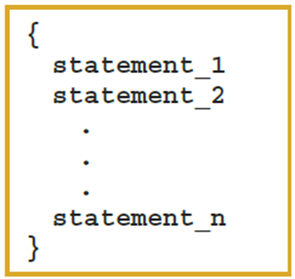
Compound (Block of) Statements (1 of 2)
A compound statement (block of statements) has this form:
A compound statement functions like a single statement

Slide 37
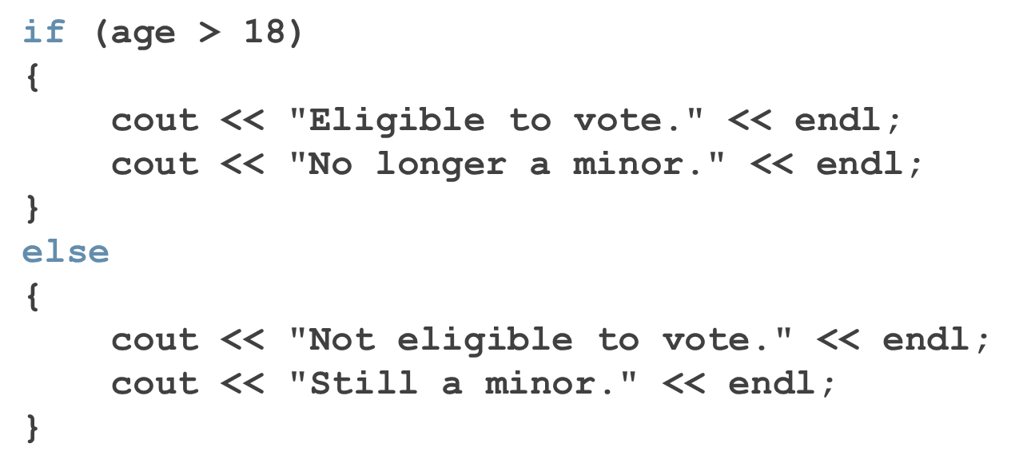
Compound (Block of) Statements (2 of 2)

Slide 38
Multiple Selections: Nested if (1 of 2)
When one control statement is located within another, it is said to be nested
An else is associated with the most recent if that has not been paired with an else

Slide 39
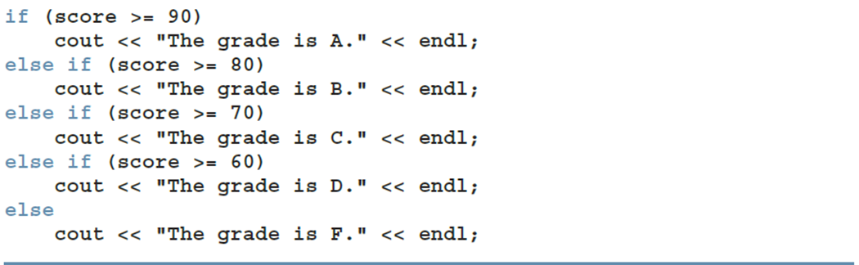
Multiple Selections: Nested if (2 of 2)
EXAMPLE 4-17
Assume that score is a variable of type int. Based on the value of score, the following code outputs the grade:

Slide 40

Ex. 1
Write a C++ program that prompts the user to enter a student's score (an integer) and outputs the corresponding grade to a file named grade.txt. The grading system follows this scheme:
A score of 90 or above results in a grade of 'A’
A score between 80 and 89 results in a grade of 'B’
A score between 70 and 79 results in a grade of 'C’
A score between 60 and 69 results in a grade of 'D’
Any score below 60 results in a grade of 'F’
Instructions:
Prompt the user to input a score (an integer).
Use a series of if, else if, and else statements to determine the correct grade based on the score entered.
Output the result in the format: "The grade is X." where X is the corresponding letter grade.
Write the result to a file named grade.txt instead of displaying it on the console.
Example Output in the File:If the user enters a score of 85, the file grade.txt should contain:

Slide 41
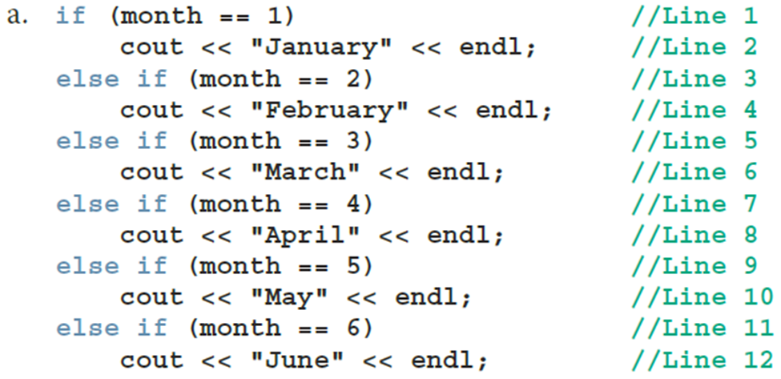
Comparing if…else Statements with a Series of if Statements (1 of 2)

Slide 42
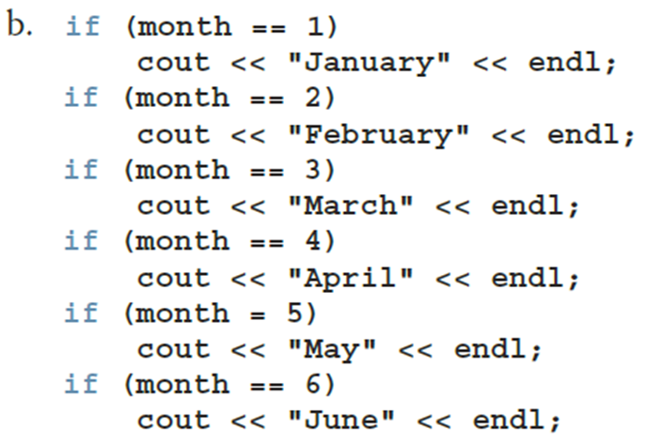
Comparing if…else Statements with a Series of if Statements (2 of 2)

Slide 43
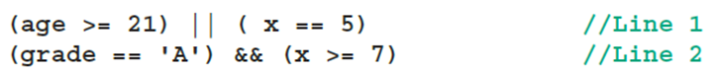
Short-Circuit Evaluation
Short-circuit evaluation: evaluation of a logical expression stops as soon as the value of the expression is known
EXAMPLE 4-21
Consider the following expressions:

Slide 44
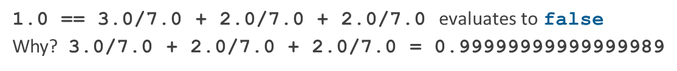

Comparing Floating-Point Numbers for Equality: A Precaution
Comparison of floating-point numbers for equality may not behave as you would expect
Example:
C++ 22 evaluates to true
A solution is checking for a tolerance value
Example:

Slide 45
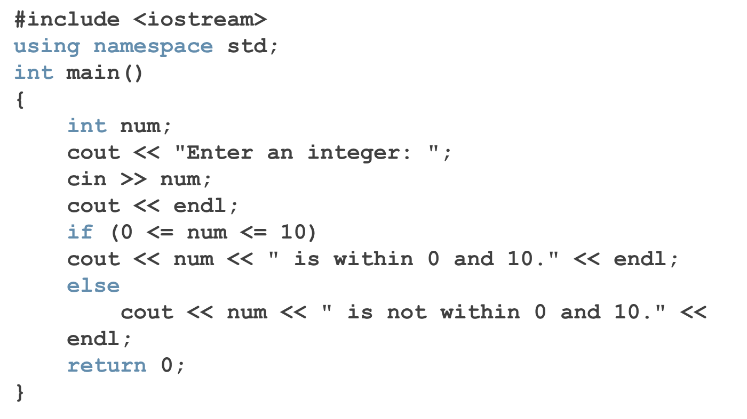
Associativity of Relational Operators: A Precaution (1 of 2)

Slide 46
Associativity of Relational Operators: A Precaution (2 of 2)
num = 5
0 <= num <= 10 | = 0 <= 5 <= 10
 | = (0 <= 5) <= 10 | (Because relational operators are evaluated from left to right)
 | = 1 <= 10 | (Because 0 <= 5 is true, 0 <= 5 evaluates to 1)
 | = 1 (true)
num = 20
0 <= num <= 10 | = 0 <= 20 <= 10
 | = (0 <= 20) <= 10 | (Because relational operators are evaluated from left to right)
 | = 1 <= 10 | (Because 0 <= 20 is true, 0 <= 20 evaluates to 1)
 | = 1 (true)

Slide 47
Avoiding Bugs by Avoiding Partially Understood Concepts and Techniques
Must use concepts and techniques correctly
Otherwise solution will be either incorrect or deficient
If you do not understand a concept or technique completely
Do not use it
Save yourself an enormous amount of debugging time

Slide 48
Input Failure and the if Statement
If an input stream enters a fail state:
All subsequent input statements associated with that stream are ignored
Program continues to execute
The code may produce erroneous results
Use if statements to check status of input stream
If the input stream enters the fail state, include instructions that stop program execution

Slide 49
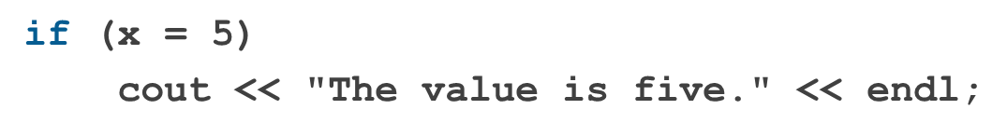
Confusion Between the Equality (==) and Assignment (=) Operators
C++ allows you to use any expression that can be evaluated to either true or false as an expression in the if statement
The appearance of = in place of == resembles a silent killer
It is not a syntax error
It is a logical error

Slide 50
Conditional Operator (?:)
Conditional operator (?:)
Ternary operator: takes three arguments
Syntax for the conditional operator
If expression1 is true, the result of the conditional expression is expression2
Otherwise, the result is expression3
Example:

Slide 51
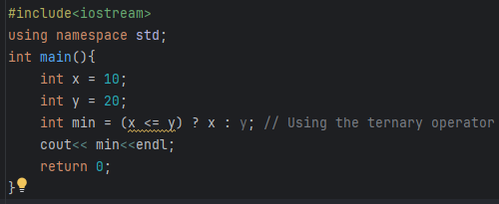
Example 1
Program 1: Find the Minimum
This program will prompt the user to enter two integers and then use the ternary operator to determine the minimum of the two numbers.

Slide 52
Example 1 Extension
Write a program using the ternary operator that takes three variables x, y, and z as input from the user, and prints out the smallest of the three numbers.
Hint: You can use nested ternary operators to compare three values.

Slide 53
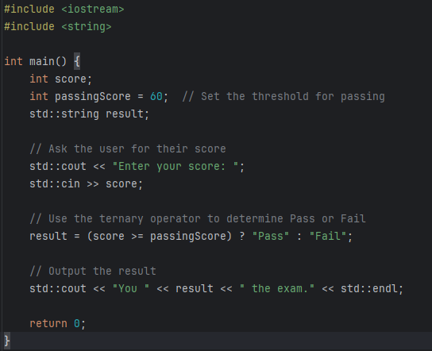
Exercise 1
Program 2: Determine the Result
This program will ask the user for their score and then use the ternary operator to determine if they pass or fail based on a passing score.

Slide 54
Program Style and Form (Revisited): Indentation
A properly indented program:
Helps you spot and fix errors quickly
Shows the natural grouping of statements
Insert a blank line between statements that are naturally separate
Two commonly used styles for placing braces
On a line by themselves
Or left brace is placed after the expression, and the right brace is on a line by itself

Slide 55
Using Pseudocode to Develop, Test, and Debug a Program
Pseudocode (or just pseudo) is an informal mixture of C++ and ordinary language
Helps you quickly develop the correct structure of the program and avoid making common errors
Use a wide range of values in a walk-through to evaluate the program

Slide 56
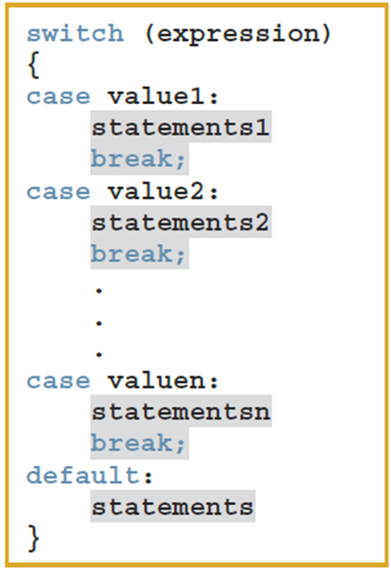
switch Structures (1 of 4)
switch structure is an alternate to if-else
switch (integral) expression is evaluated first
Value of the expression determines which corresponding action is taken
Expression is sometimes called the selector

Slide 57
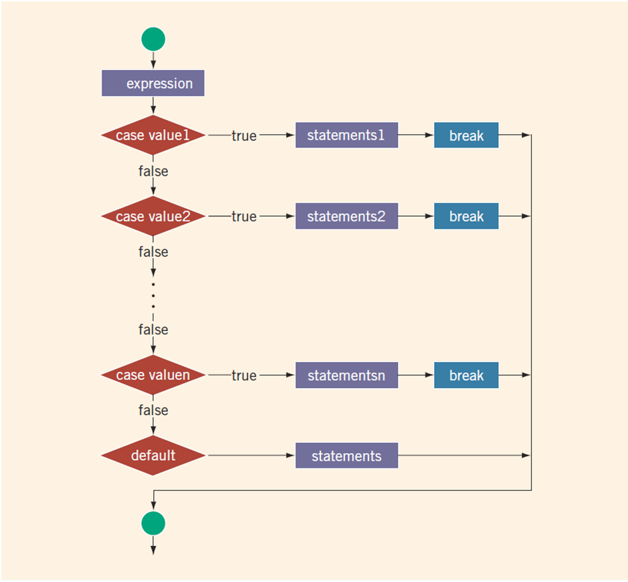
switch Structures (2 of 4)
FIGURE 4-4 switch statement

Slide 58
switch Structures (3 of 4)
One or more statements may follow a case label
Braces are not needed to turn multiple statements into a single compound statement
When a case value is matched, all statements after it execute until a break is encountered
The break statement may or may not appear after each statement
switch, case, break, and default are reserved words

Slide 59
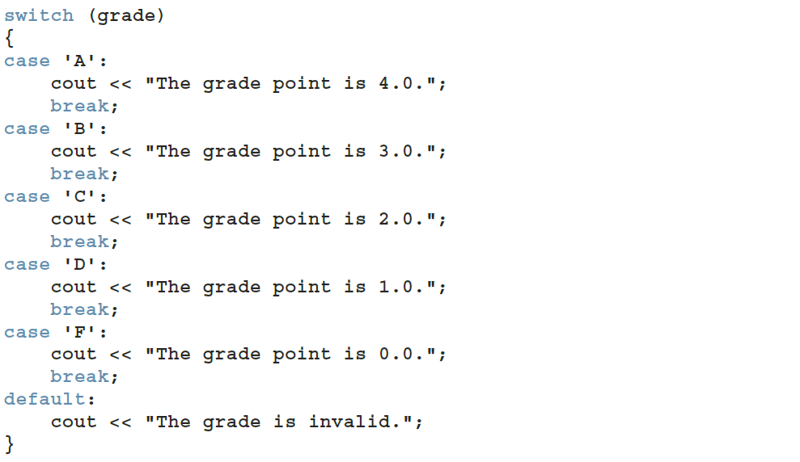
switch Structures (4 of 4)
EXAMPLE 4-22
Consider the following statements, in which grade is a variable of type char:

Slide 60
Avoiding Bugs: Revisited
To output results correctly
Consider whether the switch structure must include a break statement after each cout statement

Slide 61
Exercise 2
Write a C++ program that prompts the user to enter a student's score (an integer) and outputs the corresponding grade to a file named grade.txt. The grading system follows this scheme:
A score of 90 or above results in a grade of 'A’
A score between 80 and 89 results in a grade of 'B’
A score between 70 and 79 results in a grade of 'C’
A score between 60 and 69 results in a grade of 'D’
Any score below 60 results in a grade of ‘F’
Change this from if else to switch case

Slide 62
Terminating a Program with the assert Function
Certain types of errors are very difficult to catch
Example: division by zero
The assert function is useful in stopping program execution when certain elusive errors occur

Slide 63

The assert Function (1 of 2)
Syntax
expression is any logical expression
If expression evaluates to true, the next statement executes
If expression evaluates to false, the program terminates and indicates where in the program the error occurred
To use assert, include cassert header file

Slide 64
The assert Function (2 of 2)
assert is useful for enforcing programming constraints during program development
After developing and testing a program, remove or disable assert statements
The preprocessor directive #define NDEBUG must be placed before the directive #include <cassert> to disable the assert statement
assert(score >= 0 && score <= 100 && "Score must be between 0 and 100");

Slide 65

Quick Review (1 of 3)
Control structures alter normal control flow
Most common control structures are selection and repetition
Relational operators:
Logical expressions evaluate to 1 (true) or 0 (false)
Logical operators: ! (not), && (and), || (or)

Slide 66
Quick Review (2 of 3)
Two selection structures are one-way selection and two-way selection
The expression in an if or if...else structure is usually a logical expression
No stand-alone else statement exists in C++
Every else has a related if
A sequence of statements enclosed between braces, { and }, is called a compound statement or a block of statements

Slide 67
Quick Review (3 of 3)
Using assignment in place of the equality operator creates a semantic error
The execution of a switch structure handles multiway selection
The execution of a break statement ends a switch statement
Use assert to terminate a program if certain conditions are not met

